Slide 1




Project 1 Hotel Simulation
2021510063 Ahmetcan Temel
2021510011 Baha Aydoğan
2022510127 Kerem Kalıntaş
2022510105 Boran Bereketli

Slide 2

Introduction
The software helps the staff to manage all activities in hotel DEUCENG. It is used to manage the records of employees, customers, the states of the rooms, and reservation operations.

Slide 3


Requirements
Java Coding Language
Eclipse IDE
InteliJ IDEA
Computer

Slide 4

Task Sharing
Ahmetcan Temel: Wrote a code that can read a text file and save the informations in the txt file to the classes.
Baha Aydoğan: Initialized and added some attributes of some classes and dealt with customer class and array.
Boran Bereketli: Made the deleteEmployee , searchCustomer and searchRoom commands.He made the Reservation class and helped other classes.Tested the code.
Kerem Kalıntaş: Created Hotel, Date, Cusotmer, Adress, Staff classes.He did the statistics, simulation and list commands.

Slide 5

Scheduling
1. Discussing and designing solution alternatives. Creating the necessary variables, structures. Screen.
2. Class designs. Attributes/methods. Add and list commands for rooms.
3. Add and list commands for employee/customer/reservation. Delete command for the employee.
4. Search. Statistics. Simulation. Remaining parts of the application. Testing/Debugging.

Slide 6
Completed Tasks
Created Classes for all Hotel Structures.
Reading the commands.txt File.
Calculating the Statistic Informations.
Calculating the CustomI created Hotel, Date, Customer, Address, Main classes. I did the statistics, simulation list commands. er Satisfication.
Making the Search Algorithm.
Enabling all Commands in Commands.txt File to Work.
Making the Presentation.
Making the Reports.
Incompleted Tasks
We completed all the tasks.

Slide 7
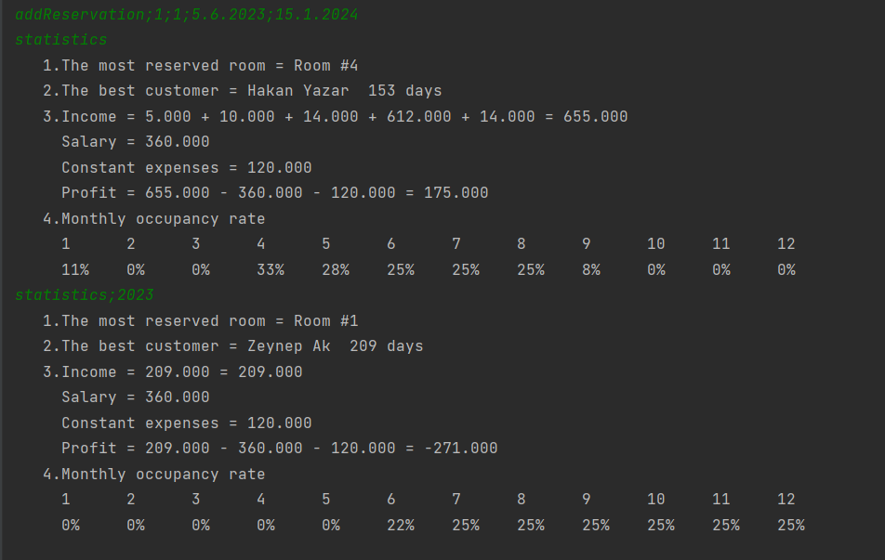
Additional Improvements

Slide 8

Problems, Algorithms And Solution Strategies
1) We couldn’t add the all commands to 2D string array while we are reading the file.
Solution Algortihm: We decided to read file line by line and we execute the our code each line.
2) We couldn’t change the phone number to string.
Solution Algorithm: We decided to write our toString method to change the phone numbers to string.
3) We had a hard time calculating the dates while we making the reservations.
Solution Algorithm: We decided to make a class for date information and we wrote a lot of methods to calculate the right date.
4) In the beginning of the project, We couldn't combine our codes properly.
Solution Algorithm: We opened a repository in GitHub and we saw how the code change over time.

Slide 9
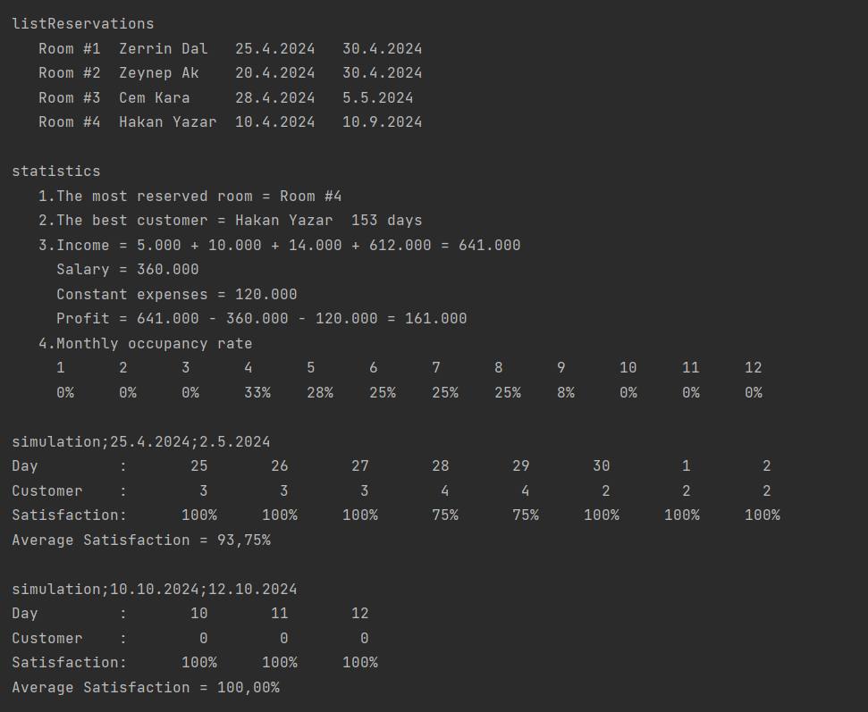
Screenshots

Slide 10
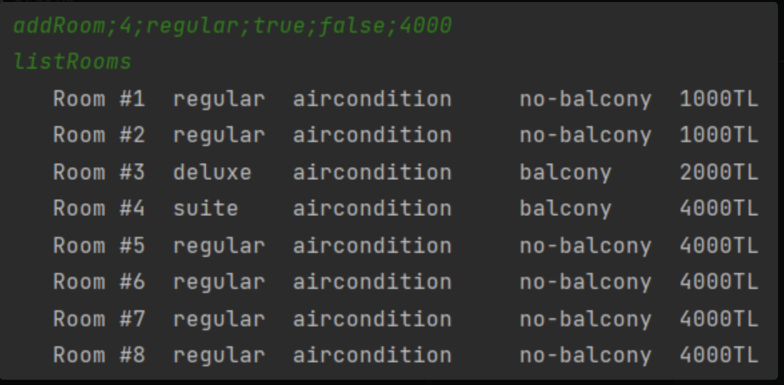
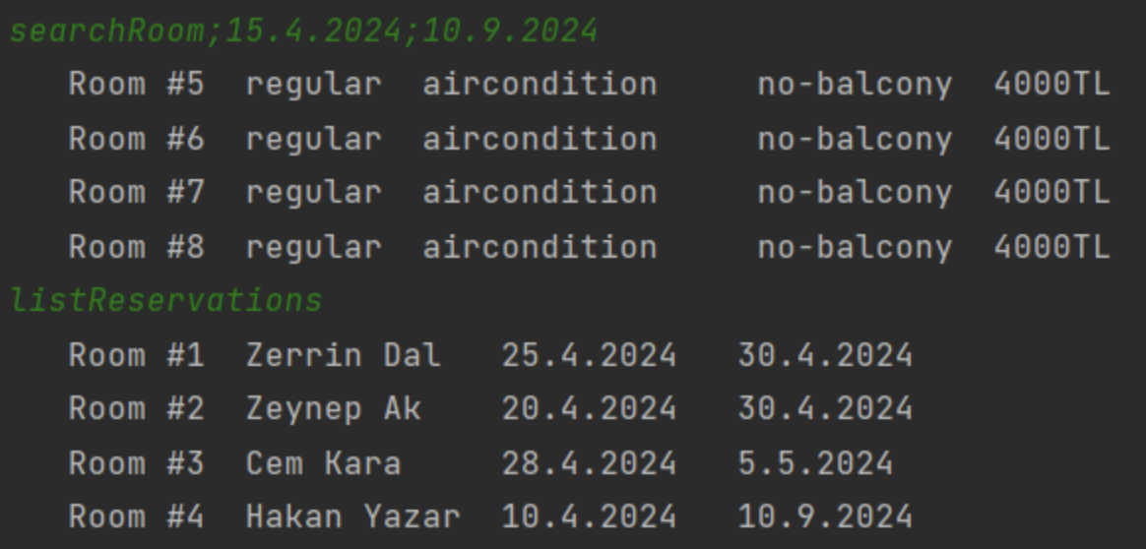
Screenshots

Slide 11
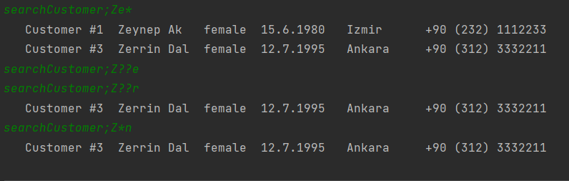
Screenshots

Slide 12

Conclusion
With this project, we learned how to create a class in java language, how to write methods in it and how to work with object oriented languages. We also improved our team work abilities in this project.

Slide 13
References
https://www.javatpoint.com/
https://www.w3schools.com/java/
https://www.geeksforgeeks.org/java/

